Slide 1

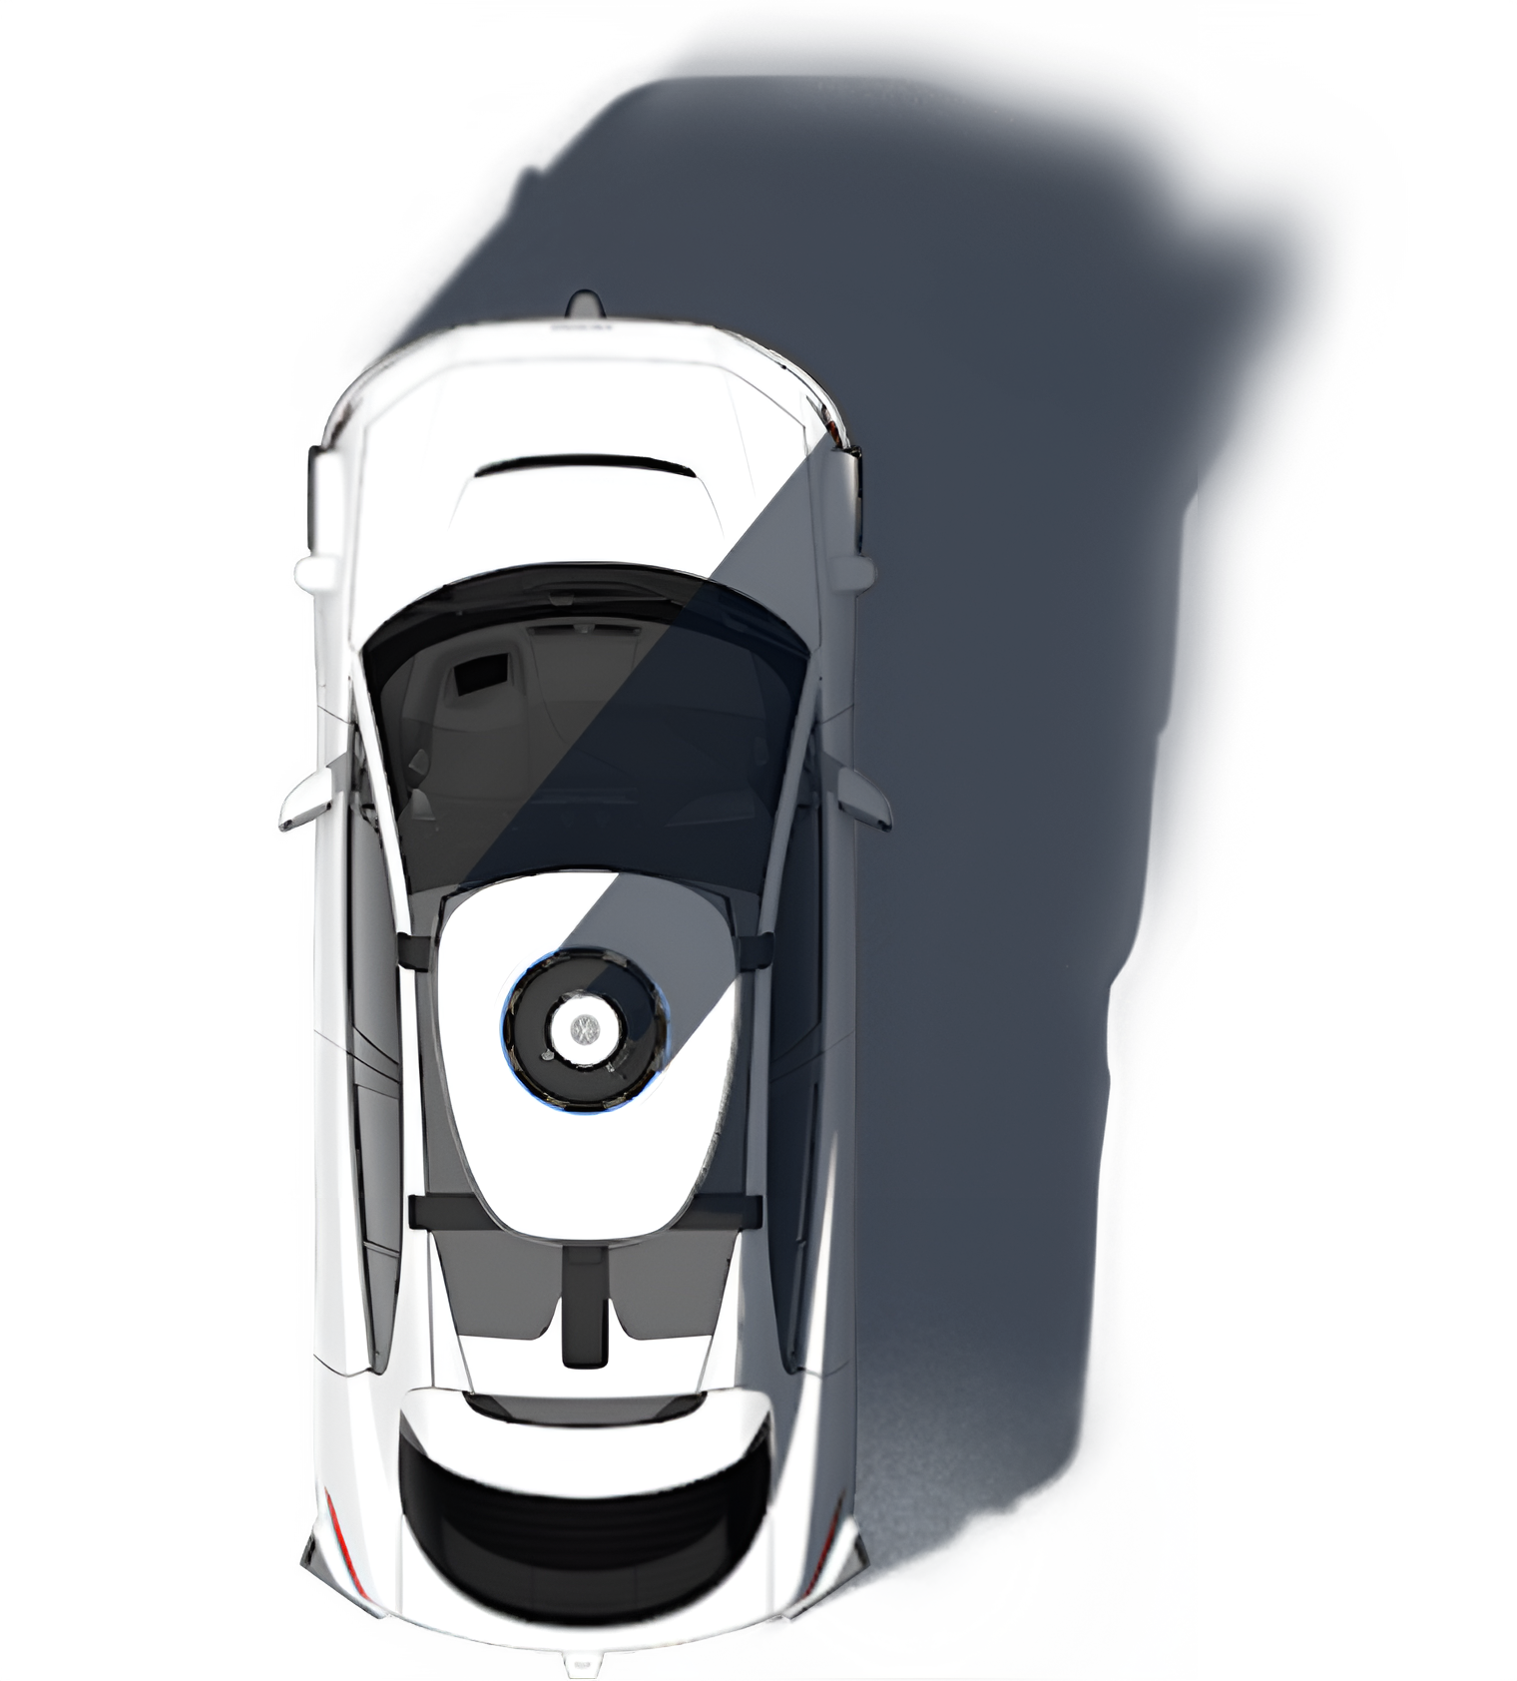
Unsupervised Statistical Learning for Kinematic Anomaly Detection in Autonomous Driving Scenarios
INTRO
Pavel Stepanov
Ramses Loaces
Justin Cabrera
Department of Computer Science University of Miami
CSC 642 · Spring 2026
Notes:
PAVEL:
Good afternoon, everyone. My name is Pavel Stepanov, and I'm here with my teammates Ramses Loaces and Justin Cabrera. Today we're presenting our research on unsupervised kinematic anomaly detection in autonomous driving.
Here's the core question that drives our work: How does an autonomous vehicle recognize that something unusual is happening on the road — without anyone ever labeling what "unusual" looks like?
That's the problem we tackle. Let's get into it.

Slide 2

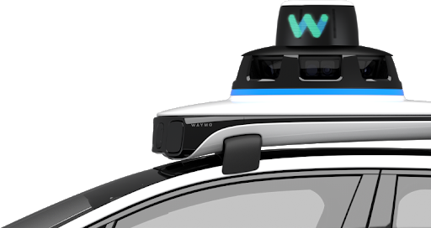
PROBLEM
The Long-Tail Problem in Autonomous Driving
Most driving is routine and predictable.
Safety-critical events are rare but risky:
Anomaly data is scarce, and “danger” depends on context.
Sudden braking or acceleration
Jaywalking pedestrians
Near-misses
Notes:
PAVEL:
Autonomous vehicles are getting very good at handling the everyday: steady highway cruising, predictable lane-following, routine intersections. But safety-critical incidents live in the long tail of driving distributions — sudden braking, aggressive lane changes, a pedestrian running into the street.
The challenge is that these events are rare by definition, so labeled examples are scarce. You can't train a supervised classifier without labels. And the definition of "dangerous" is subjective — a 30 km/h speed is fine on a highway, alarming in a crosswalk.
This is exactly where unsupervised learning shines: we don't need labels. We let the data tell us what's normal, and then flag what falls outside that.

Slide 3

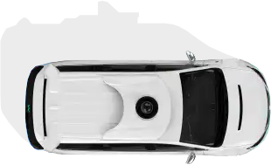
MOTIVATION
The Long-Tail Problem in Autonomous Driving
Unsupervised learning lets the data define normal — and flags what falls outside.
Goal 1 | Goal 2
Detect anomalous agents from kinematics alone — no labels | Predict 5-second future displacement from current kinematic state
Notes:
PAVEL:
We had two concrete goals:
Detect anomalous motion patterns from kinematic signals alone — no human annotation.
Predict where an agent will be in 5 seconds using only its current kinematic state.
Both are essential for an AV that needs to proactively plan around unexpected behavior.

Slide 4
RELATED WORK
Where This Work Fits
Method | Type | Strength | Limitation
Kalman Filter | Classical | Interpretable, fast | Linear dynamics only
LSTM / GRU | Deep learning | Captures sequences | Needs large labeled data
Transformer | Deep learning | State-of-the-art accuracy | Black box, expensive
One-Class SVM | Unsupervised | No labels needed | Kernel tuning sensitive
Isolation Forest | Unsupervised | Scalable, minimal assumptions | No temporal context
Prior work on WOMD focuses on deep learning prediction.
Classical statistical baselines over the full agent population remain unexplored.
This work fills that gap.
Notes:
RAMSES: 1. Looking at the current landscape, the industry is heavily focused on Deep Learning specifically LSTMs and Transformers. They’re accurate, but they have two major flaws for our goals: they’re 'black boxes' and they require massive amounts of labeled data. We wanted a method that was more transparent and didn't rely on human-labeled examples.
2. We then explored unsupervised options like the One-Class SVM. While it doesn’t need labels, it’s incredibly finicky. It tries to draw a tight boundary around 'normal' data, but if your tuning is even slightly off, the model fails. It’s too sensitive for the varied environments we see in the Waymo dataset.
3. That led us to our core approach: the Isolation Forest. The logic is simple: Anomalies are 'few and different.' Think of it this way: if you randomly split the data, an outlier is 'easy to corner.' It takes fewer steps to isolate a reckless lane change than it does to isolate a car driving at the speed limit. We use this 'path length' to generate a score—the shorter the path, the higher the likelihood of an anomaly.
4. Ultimately, we’re filling a major gap. While everyone else is building complex prediction pipelines, we are proving that interpretable, statistical baselines can effectively capture the 1% of incidents that actually matter.

Slide 5
RELATED WORK: REFERENCES
Reference
[1] M. A. Pimentel, D. A. Clifton, L. Clifton, and L. Tarassenko, “A review of novelty detection,” Signal Processing, vol. 99, pp. 215–249, 2014.
S. Ettinger, S. Cheng, B. Caine, C. Liu, H. Zhao, S. Pradhan, Y. Chai, B. Sapp, C. R. Qi, Y. Zhou et al., “Waymo open dataset: Perception and prediction,” in Proceedings of the IEEE/CVF International Conference on Computer Vision, 2021, pp. 10 308–10 317.
[2] F. T. Liu, K. M. Ting, and Z.-H. Zhou, “Isolation forest,” in 2008 Eighth IEEE International Conference on Data Mining. IEEE, 2008, pp. 413–422.
[3] B. Sch¨ olkopf, J. C. Platt, J. Shawe-Taylor, A. J. Smola, and R. C. Williamson, “Estimating the support of a high-dimensional distribution,” Neural computation, vol. 13, no. 7, pp. 1443–1471, 2001.
[4] P. Sun, H. Kretzschmar, X. Dotiwalla, A. Chouard, V. Patnaik, P. Tsui, J. Guo, Y. Zhou, Y. Chai, B. Caine et al., “Scalability in perception for autonomous driving: An academy-industry joint effort,” in Proceedings of the IEEE/CVF Conference on Computer Vision and Pattern Recognition, 2020, pp. 2448–2458.
[5] Y. Zhou, S. Ettinger, S. Cheng, B. Caine, C. Liu, S. Pradhan, B. Sapp, C. R. Qi, Y. Chai, T. Huang et al., “Waymo open motion dataset: A large-scale dataset for motion prediction in autonomous driving,” in Proceedings of the IEEE/CVF Conference on Computer Vision and Pattern Recognition, 2020, pp. 9710–9719
Notes:
RAMSES:
Our project addresses the challenge of identifying rare, high-risk driving events. We grounded our work in the Pimentel [1] and Schölkopf [4] frameworks for novelty detection, which allow us to model 'normal' driving without needing a labeled database of every possible crash scenario.
To find these incidents efficiently, we utilized the Isolation Forest [3] method—it’s conceptually powerful because it assumes anomalies are easier to 'separate' from the pack than normal data is to define.
We tested this logic against the Waymo Open Motion Dataset [6], specifically targeting the 'long-tail' scenarios described in Waymo’s core research [2, 5]. By combining these established statistical methods with Waymo's real-world sensor data, we successfully isolated anomalies based on kinematic extremes in speed, yaw, and acceleration."

Slide 6
DATASET & PIPLINE
Waymo Open Motion Dataset v1.3.1
18,311 raw agent observations — 20 Hz object tracking — 20-second scenario segments
01
02
03
waymo_final_dataset.csv
Python Notebook
04
Waymo
GCS Bucket (TFRecords)
GCS authentication
Parse Scenario protos
Extract kinematics at t = 0, t = -0.1s, t = +5s
R — Statistical Modeling
Preprocessing → Anomaly Detection → Motion Prediction
05
Results (Tables / Plots)
*Features extracted: Speed, Acceleration, Yaw Rate, Vel_X, Vel_Y Length, Width, FutureDist_5s
Notes:
PAVEL:
We work with the Waymo Open Motion Dataset v1.3.1 — one of the largest real-world AV datasets available publicly. It provides 20 Hz object tracks over 20-second urban driving segments, with rich metadata: agent type (vehicle, pedestrian, cyclist), bounding boxes, interaction flags, and traffic signals.
Our pipeline has two stages.
First, Python running in Google Colab pulls raw TFRecord shards from Waymo's Google Cloud Storage bucket and extracts a tabular feature set for over 18,000 agents across hundreds of scenarios.
We extract the kinematic state at the prediction moment: speed, acceleration, yaw rate, velocity components, and the future 5-second displacement.
That CSV then flows into R, where all statistical modeling happens.
The two analyses use different preprocessing. For anomaly detection, we apply the strictest filter: valid sensor frames only, stationary agents removed, and complete cases across all kinematic and geometric features — leaving 4,538 moving agents. For regression, the goal is different — we actually want to compare behavior with and without stationary agents — so we start from a more permissive filter: NA removal only, no speed cutoff. That gives us 6,614 agents including stationary ones, which we then split into two conditions for the comparison.

Slide 7
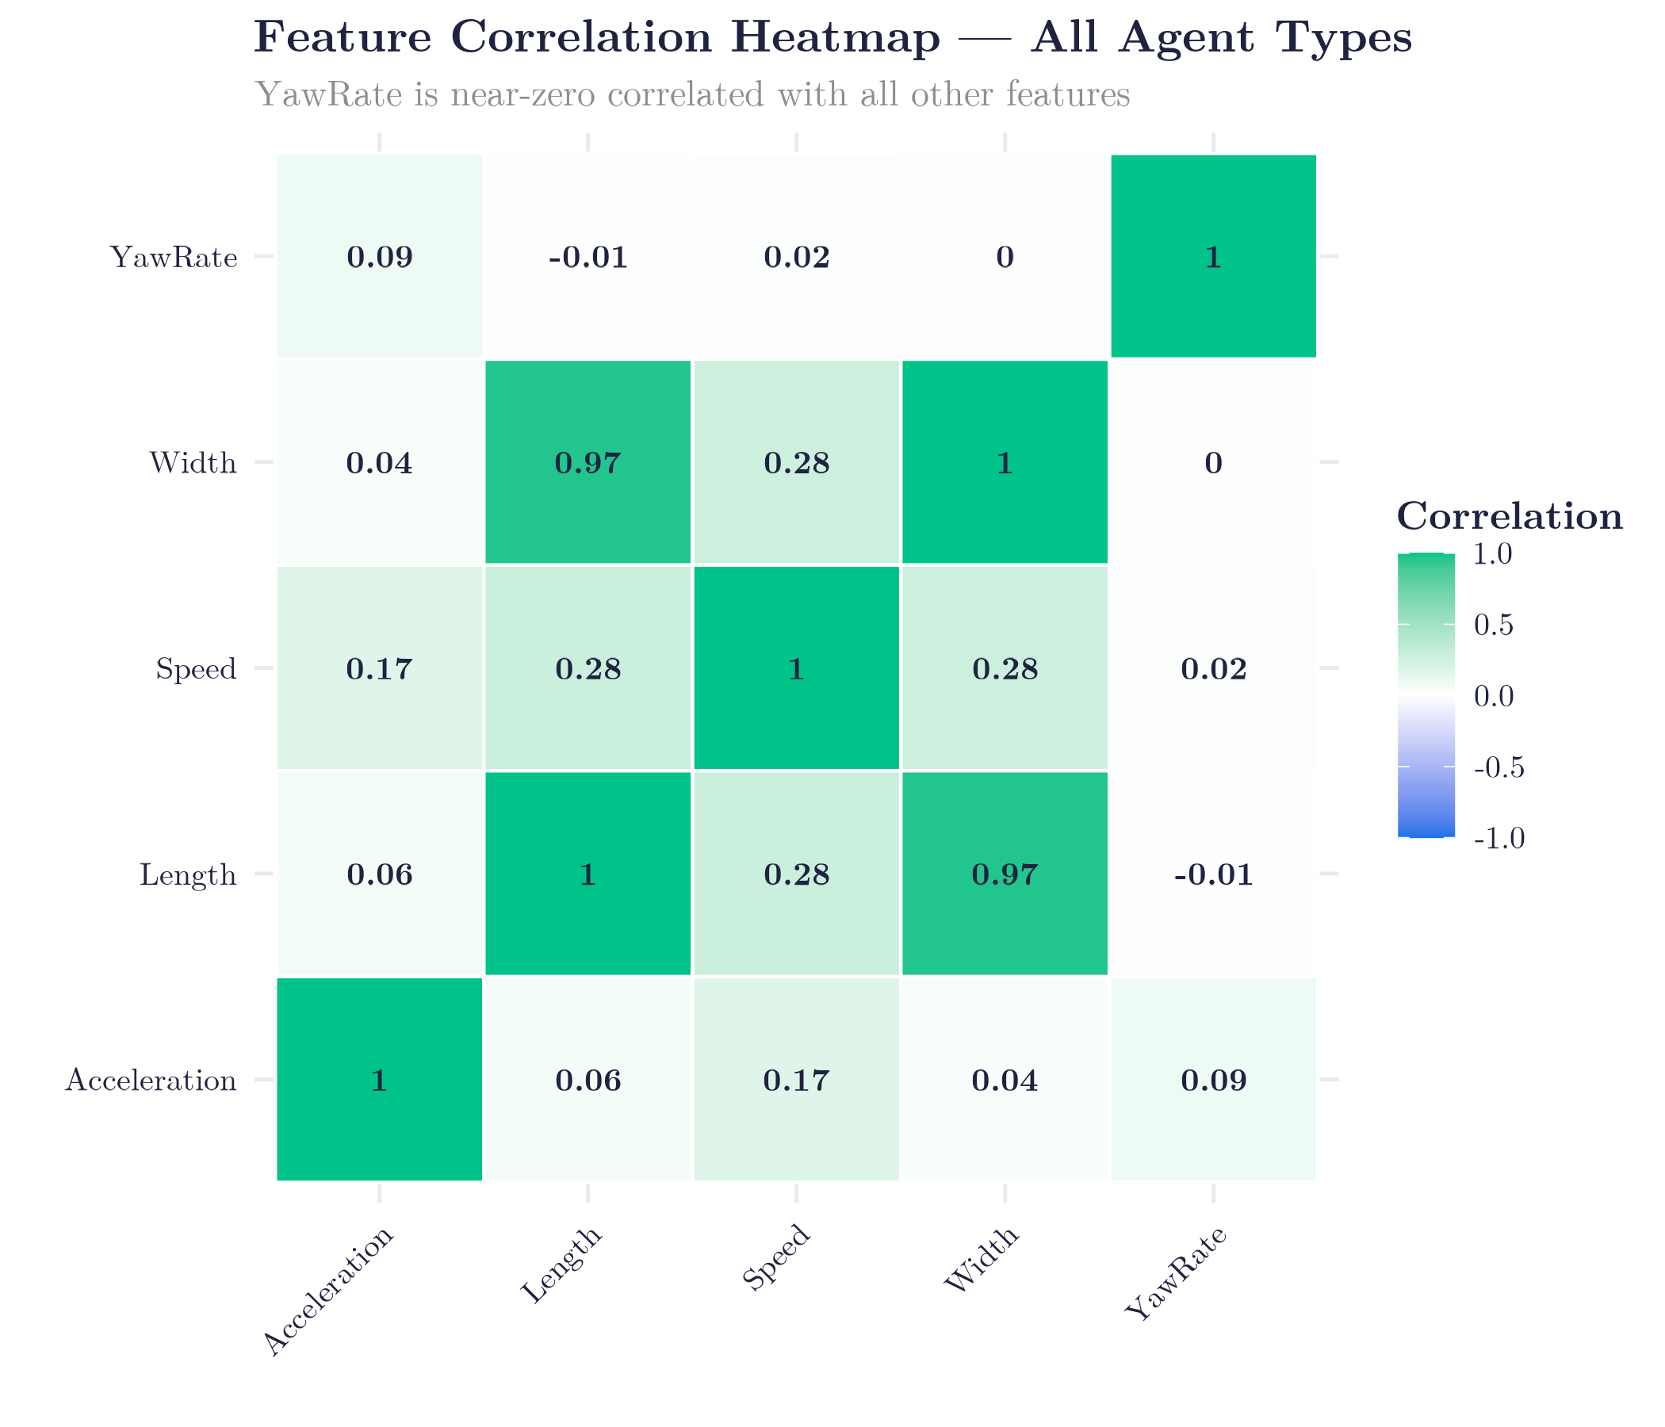
PART 1: DATASET STATISTICS
What the Data Looks Like
Agent Type | Count (raw) | After preprocessing
Vehicle | majority | included
Pedestrian | ~25% | included
Cyclist | ~5% | included
SDC (AV itself) | removed | excluded
Notes:
JUSTIN:
Before diving into the models, let me give you a feel for what this data actually looks like.
In terms of composition: vehicles make up roughly 70% of the dataset, pedestrians around 25%, and cyclists about 5%. The Waymo self-driving car — the SDC — is excluded from all analysis. This class imbalance matters: it affects the anomaly distribution and how we interpret per-class statistics. [Point to correlation heatmap]
The heatmap here shows Pearson correlations across all kinematic features. The key finding: yaw rate is essentially uncorrelated with everything else — |r| ≤ 0.09 across the board. Length and width are nearly redundant at r ≈ 0.97. Speed and length share a weak positive relationship.
This independence of yaw rate is not a nuisance — it's exactly what makes it a strong discriminating feature for anomaly detection. It carries information no other variable does. You'll see why that matters in the next slide.
One last note on Waymo's behavioral flags: IsInteractive marks agents relevant to the AV's immediate planning — nearby vehicles at intersections. It is not a safety-incident label. That distinction will matter when we look at the results.

Slide 8
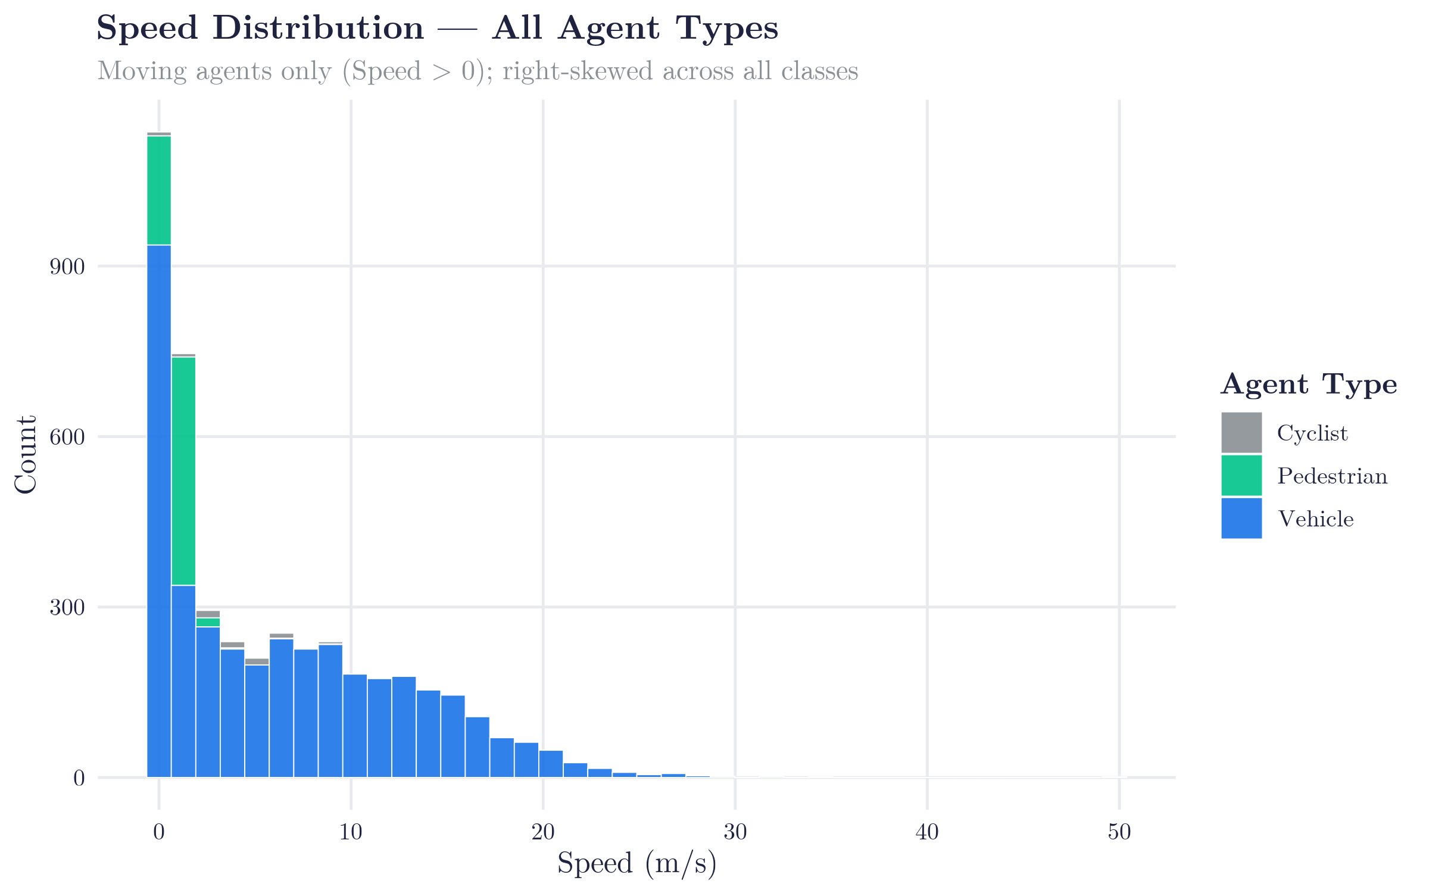
PART 2: DATASET STATISTICS
What the Data Looks Like
Notes:
JUSTIN:
[Point to speed distribution histogram]
Here's the speed distribution across all three agent types. One thing stands out immediately: vehicles appear slower than cyclists in the raw data — which seems wrong. It's entirely because a large fraction of vehicles are stopped at intersections. Once you filter to moving agents only, the expected ordering snaps back: vehicles fastest, then cyclists, then pedestrians. That's an important preprocessing consideration we carry into both models.

Slide 9
PART 3: DATASET STATISTICS
Results: Descriptive Statistics
Mean Speed by Agent Type (m/s)
Agent Type | Stationary & Non-Stationary | Moving Only
Vehicle | 2.47 | 6.74
Pedestrian | 4.20 | 3.92
Cyclist | 1.01 | 1.01
Without filtering: vehicles appear slower than cyclists due to stopped cars at intersections. Filtering restores expected ordering.
— 80 / 20 train / test split
— 5-fold cross-validation on training set.
— Metrics: RMSE (meters) · R²
"
Stationary agents have near-zero displacement — trivially easy to predict. The two conditions reveal whether R² reflects real predictive power or dataset composition.
Notes:
JUSTIN:
These results gave us some confidence in the intuition behind our starting data (vehicles moving faster than pedestrians)

Slide 10

METHODS: ANOMALY DETECTION
Two-Layer Anomaly Detection Pipeline
03
Notes:
RAMSES: Our anomaly detection pipeline has two layers — and as Justin just showed, the choice of yaw rate as a key feature comes directly from that correlation analysis.

Slide 11
ANOMALY DETECTION
Layer 1 — Isolation Forest
01
— Features: Speed, Acceleration, YawRate — YawRate uncorrelated with all others
— 100 trees, unsupervised, no labels
— Threshold: 99th percentile → 46 flagged out of 4,538
03
(|r| ≤ 0.09)
Layer 2 — Statistical Validation
02
— Fisher's Exact Test (Monte Carlo, 2,000 replicates)
— p = 0.0005 — anomalies cluster by agent type, not random noise
Notes:
RAMSES: Layer 1: Isolation Forest. We fit 100 trees on Speed, Acceleration, and YawRate. Each agent receives an anomaly score between 0 and 1. We threshold at the 99th percentile — flagging 46 agents out of 4,538 as anomalous.
Layer 2: Statistical Validation. We build a contingency table of agent type versus anomaly status and run Fisher's Exact Test with Monte Carlo simulation. Result: p = 0.0005. The anomalies are not uniformly distributed — certain agent types are disproportionately flagged. That's signal, not noise.

Slide 12
MOTION PREDICTION
Linear Regression for 5-Second Displacement
Formula
$$Δd_{5s}=β_{0}+β_{1}⋅\text{Speed}+β_{2}⋅\text{Acceleration}+β_{3}⋅\text{YawRate}+β_{4}⋅V_{x}+β_{5}⋅V_{y}$$
Layer 1 — Isolation Forest
 | Condition A | Condition B
Dataset | All Agents | Moving agents only (Speed > 0)
N | 6,614 | 3,196
Purpose | Baseline including easy cases | Honest evaluation under dynamics
— 80 / 20 train / test split
— 5-fold cross-validation on training set.
— Metrics: RMSE (meters) · R²
"
Stationary agents have near-zero displacement — trivially easy to predict. The two conditions reveal whether R² reflects real predictive power or dataset composition.
Notes:
JUSTIN: For motion forecasting we use a linear regression model predicting 5-second future displacement from the full kinematic state: speed, acceleration, yaw rate, and the signed velocity components Vx and Vy.
We evaluate under two conditions — intentionally.
Condition A includes all agents: moving and stationary.
Condition B restricts to moving agents only, giving us 3,196 observations.
Stationary agents have near-zero displacement — trivially easy to predict and likely to inflate R-squared. The two-condition design lets us directly measure that inflation.
Both models were trained with 5-fold cross-validation and evaluated on a held-out 20% test set.

Slide 13
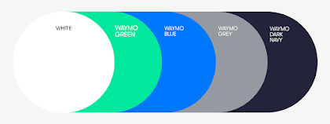
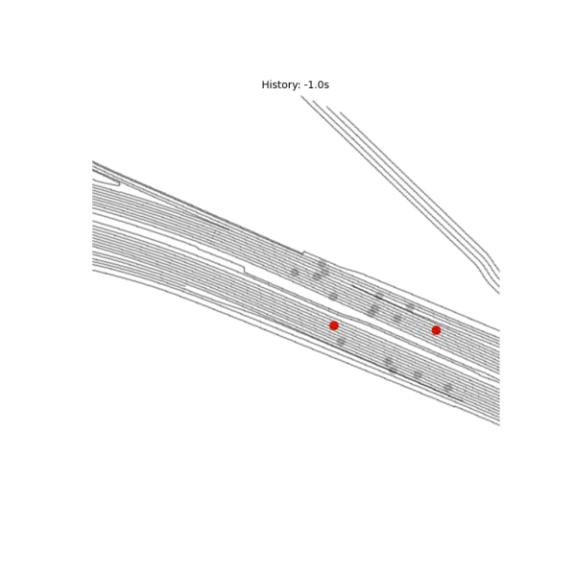
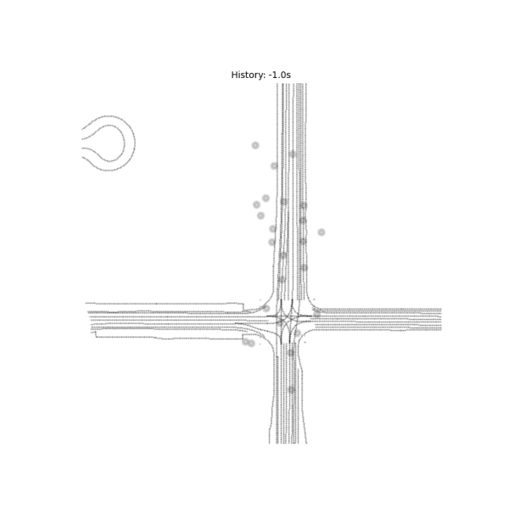
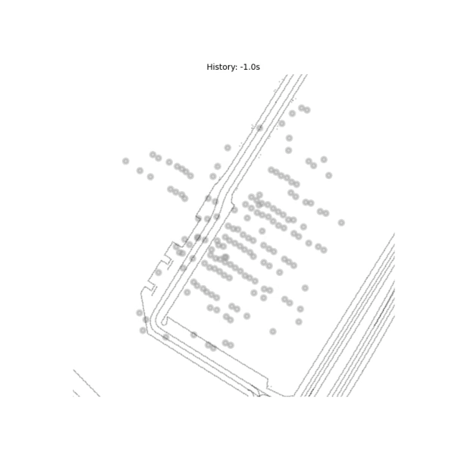
DEMO
Visual Results
Sensor Artifact
Most of our Anomolies
Speeding Vehicles
Lane Change
Stationary agents have near-zero displacement — trivially easy to predict. The two conditions reveal whether R² reflects real predictive power or dataset composition.
Notes:
JUSTIN:
Lets look at a couple scenarios.
The 1% Anomlous events identified 46 anomolyous agents, over about 22 scenarios. When running the actual scenarios, identifying the anomaly as a red dot, we see that most of the insances appear as the sensor artifact does. We propose that the anomolyous events identified are machine defaults that do not necessarily capture geniuine vehicle safety cases, but it captures a significant instance – a sensor artifact when measuring the environment.
There's one more detail worth highlighting: none of the top anomalies carry an IsInteractive flag from Waymo. IsInteractive marks agents that are safety-relevant to the AV's immediate planning. Our most extreme kinematic outliers — the 180 km/h vehicle, the ±31 rad/s artifacts — were not flagged by Waymo as planning-relevant. We'll come back to what that means in discussion, but it's an important caveat to carry into the results.

Slide 14
RESULTS
Results: Motion Prediction Results
Linear Regression — 5-Second Displacement
Dataset | Test RMSE | Test (Hold-out) | CV RMSE | CV R²
With stationary | 7.44 m | 0.880 | 7.65 m | 0.886
Without stationary | 13.15 m | 0.728 | 10.05 m | 0.860
Notes:
PAVEL:
For motion prediction: with stationary agents included, test RMSE 7.44 meters, R-squared 0.880. Remove stationary agents and RMSE jumps to 13.15 meters, R-squared drops to 0.728.

Slide 15
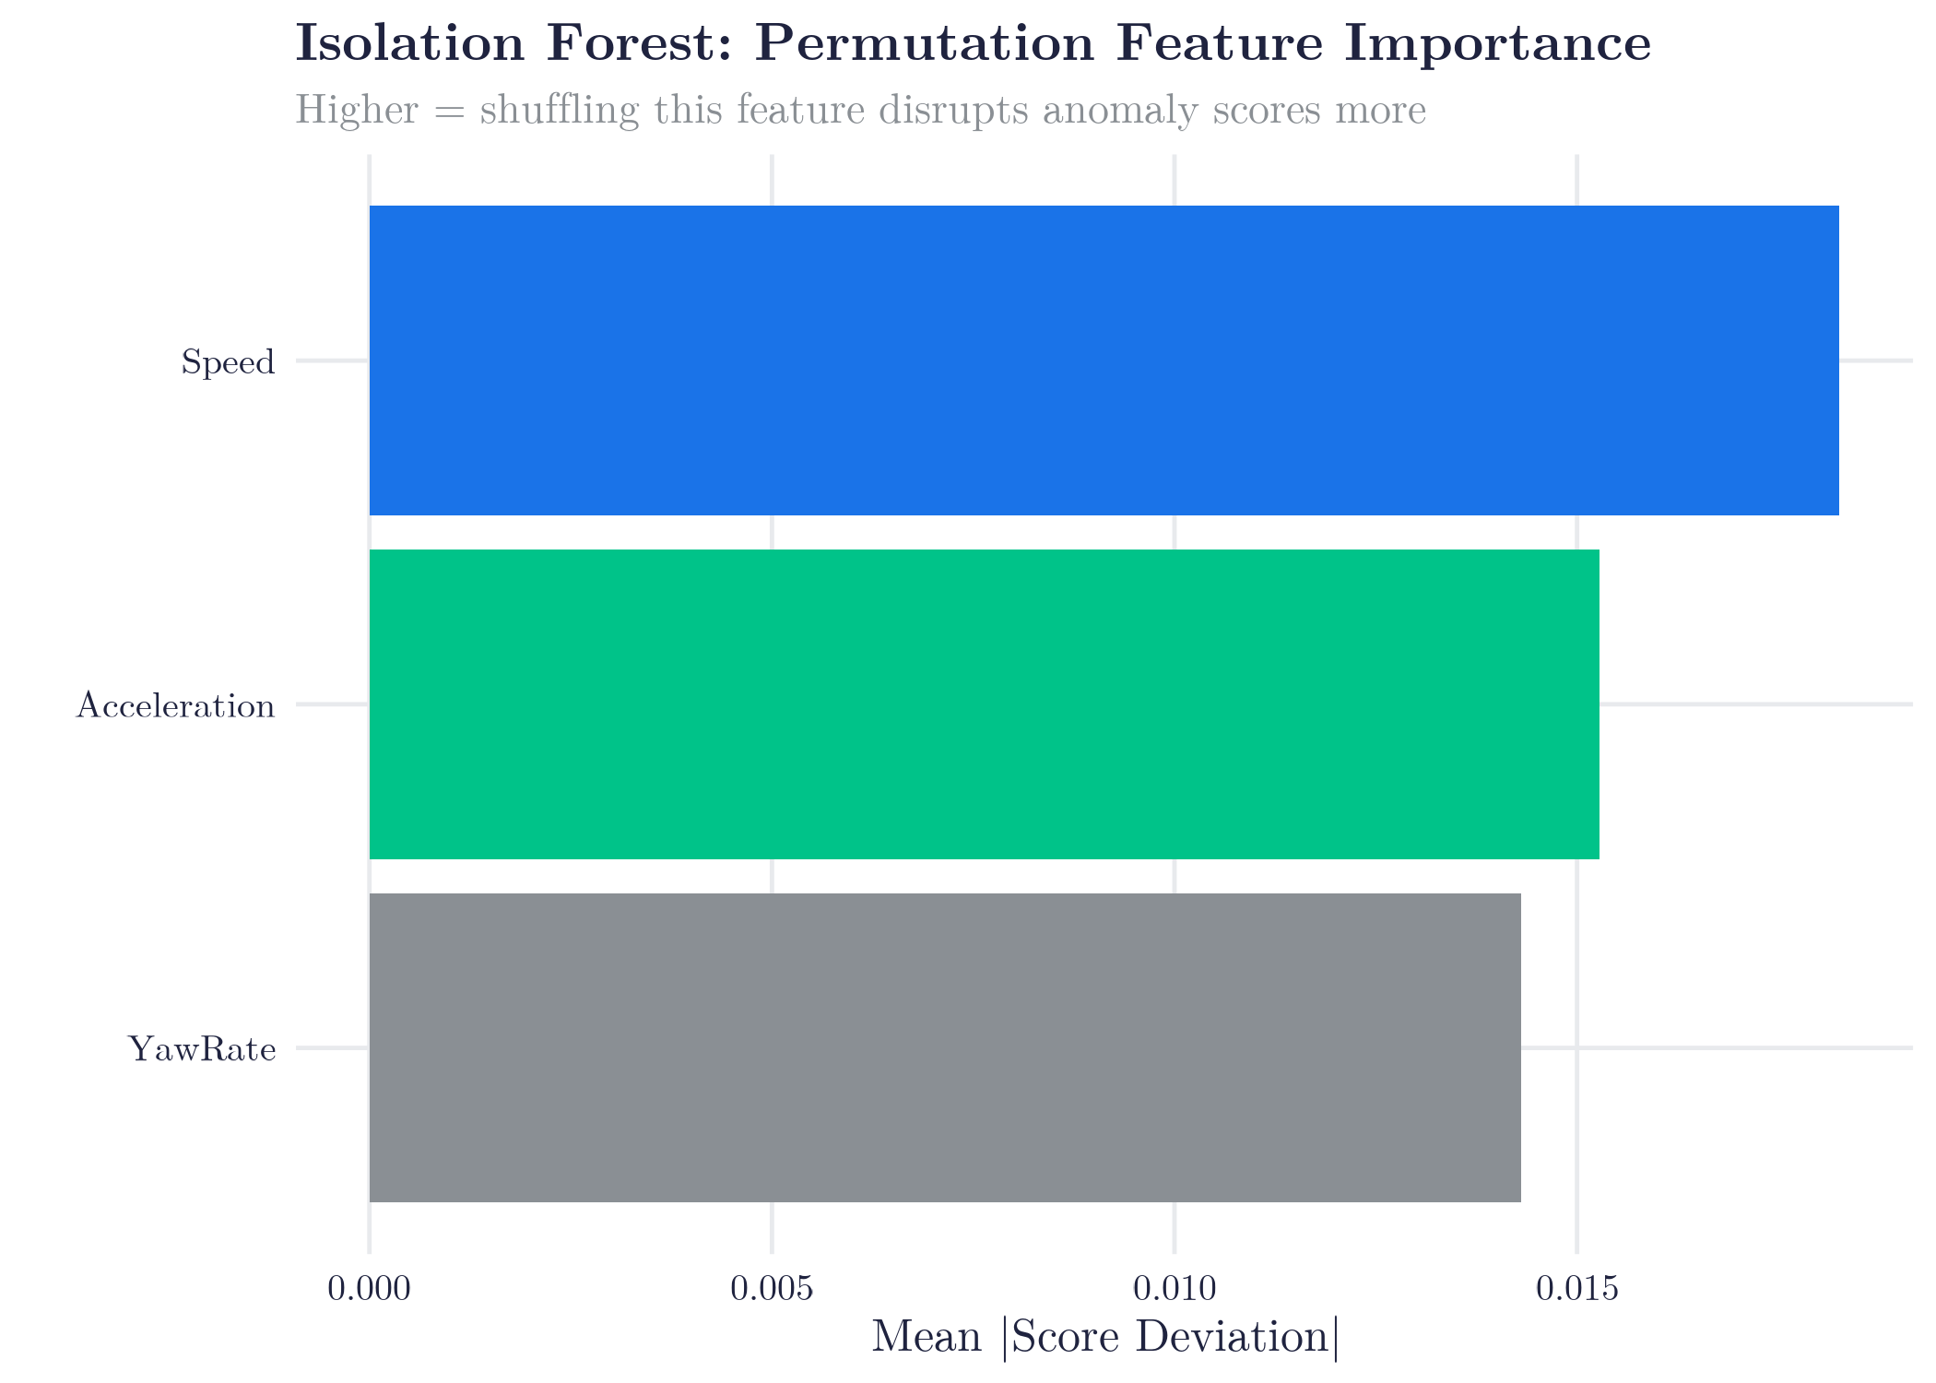
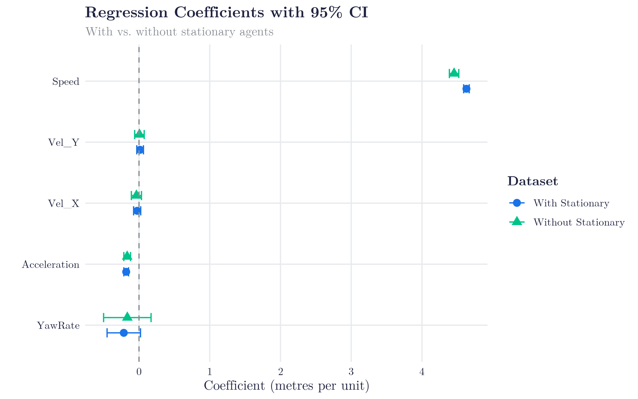
RESULTS: FEATURES
Results: Feature Importance
— 80 / 20 train / test split
— 5-fold cross-validation on training set.
— Metrics: RMSE (meters) · R²
"
Stationary agents have near-zero displacement — trivially easy to predict. The two conditions reveal whether R² reflects real predictive power or dataset composition.
Notes:
JUSTIN:
The standardized beta coefficients give us the feature importance for the regression — and the picture could not be clearer. Speed dominates with β ≈ 0.95, essentially the entire predictive signal. ;
The anomaly detection story is structurally different
Isolation Forest doesn't assign importance to individual features the way a regression does — it works by randomly selecting features and split values across 100 trees, mixing over Speed, Acceleration, and YawRate in different combinations every time.
It's the joint structure across the full kinematic space that determined what got isolated.

Slide 16

DISCUSSION & LIMITATIONS
What the Results Tell Us
Takeaway 1: Unsupervised detection works | Takeaway 2: Dataset composition dominates metrics
IF scores carry real discriminative signal p = 0.0005 confirms structure, not noise Anomalies concentrate in pedestrians / cyclists — consistent with irregular urban kinematics | Removing stationary agents: ΔR² = −0.15 Not a model failure — a dataset artifact Benchmarks on mixed populations are inflated Moving-only evaluation is the honest number for dynamic AV deployment
Limitations:
Pseudo-labels: 46 anomaly labels come from IF scores, not verified ground truth
— test specificity of 0.667 reflects this noise
Single frame: We use one snapshot per agent, ignoring the full 20-second trajectory
Linear model: Pedestrian and cyclist motion may be nonlinear
No temporal context: Isolation Forest operates on instantaneous kinematics only
Notes:
RAMSES:
1. The Reality Check: Outliers ≠ Crashes (40s)
Before the takeaways, there’s a really important nuance to address. Statistically, our model performed great—the p-values and AUC numbers are strong. However, when we looked at our top 20 'anomalies,' they didn't match Waymo's internal safety flags. This showed us that A kinematic outlier is not always a safety incident. Our model did find extreme speeds and sensor glitches that would normally go unnoticed.
2. Takeaway 1: Unsupervised Learning is Legitimate (30s)
The first big takeaway is that unsupervised detection actually works. We don’t need human labels to find structure in the chaos. Even after filtering out stationary agents, our model identified some genuine behavior anomalies with extreme acceleration erratic manevering – plus a significant pattern of sensor artifacts that would have gone unnoticed otherwise.
3. Takeaway 2: Don't Trust "Inflated" Numbers (30s)
The second takeaway is a warning for other researchers: Dataset composition is everything. When we removed parked or stationary cars, our performance dropped significantly. This tells us that many models look good only because they are 'cheating' by correctly identifying easy, parked cars. Our score on moving agents is the honest number for how this works in a real, dynamic environment.
4. The Bottom Line & Limits (20s)
To wrap up, we have some limitations we only looked at single snapshots and we used a linear model for a non-linear world. But by filling this gap with a simple statistical baseline, we've created a transparent way to audit how 'normal' or anomolus' an agent is behaving.

Slide 17
CONCLUSION & FUTURE WORK
Summary & Next Steps
Next Steps:
Stage 1 — Anomaly Detection
Isolation Forest on Speed / Acceleration / Yaw Rate
Fisher's Exact Test: p < 0.001
Temporal features over the full 20-second trajectory
Validate anomalies against Waymo's IsInteractive ground-truth flags
Mahalanobis distance scoring as IF alternative
Neural extensions benchmarked against these baselines
Stage 2 — Motion Prediction
Linear regression on 5 kinematic features
R² = 0.88 with stationary agents included
Strong classical baseline
Notes:
PAVEL:
To summarize: we built a two-stage statistical pipeline for autonomous driving data.
Stage one: Isolation Forest detects kinematic anomalies unsupervised. Fisher's Exact Test validates them at p < 0.001. And manual inspection reveals both genuine extreme events and a systematic sensor artifact that only became visible through the anomaly detection step.
Stage two: Linear regression predicts 5-second displacement with R-squared of 0.88 — a strong classical baseline.
The result: interpretable, reproducible statistical methods can deliver meaningful safety-relevant insights from large-scale real-world AV data, without any deep learning — and with the important caveat that interpreting those insights requires understanding what each model is and isn't measuring.
For future work, three extensions:
Filter yaw rate at |yaw| < 10 rad/s before anomaly detection, to remove the sensor artifact and surface more meaningful behavioral anomalies.
Validate flagged agents against Waymo's IsInteractive flag as a soft reference label, with appropriate caveats about what that flag actually represents.
Apply the pipeline to the full dataset — not just 300 scenarios — to get a richer tail of genuine high-speed events.
Our full code is open-source on GitHub.
Thank you — we're happy to take questions.

Slide 18
Q&A
Thank You — Questions?
Pavel Stepanov — pas273@miami.edu
Ramses Loaces — rxl1238@miami.edu
Justin Cabrera — justin.cabrera2718@gmail.com
Notes:
Q: Why Isolation Forest and not One-Class SVM?
Isolation Forest scales better to our dataset size (~4,500 agents) and requires no kernel tuning. One-Class SVM is sensitive to the nu hyperparameter and the kernel choice; IF is more robust out of the box and interpretable via feature importance.
Q: The 99th percentile threshold — isn't that arbitrary?
It's a design choice, yes. We chose 1% to ensure only the most extreme kinematic outliers are flagged. The Fisher test validates that this threshold produces statistically meaningful, non-random groups. A lower threshold would give more recall at the cost of precision.
Q: None of the top 20 were IsInteractive — does that mean the results are useless?
No — it means we're measuring something different from what IsInteractive tracks. IsInteractive is a proximity-based planning flag for routine AV decisions. Our pipeline finds kinematic extremes that fall outside normal operating ranges and surfaces data quality issues. Those are complementary, not competing, signals.
Q: Why linear regression and not something more powerful for prediction?
Intentionally. We wanted to establish a classical baseline first. An R-squared of 0.88 from a linear model means there's strong linear signal in the kinematic features. Neural approaches should be benchmarked against this, not introduced without first knowing what simpler methods can already achieve.
Q: How generalizable are these results beyond Waymo?
The kinematic features we use — speed, acceleration, yaw rate — are universal to any tracked agent. The pipeline is dataset-agnostic. The specific thresholds and model weights would need retraining, but the methodology transfers directly. The sensor artifact finding (±31 rad/s at near-zero speed) may also appear in other datasets using the same heading derivative computation.

